Slide 1
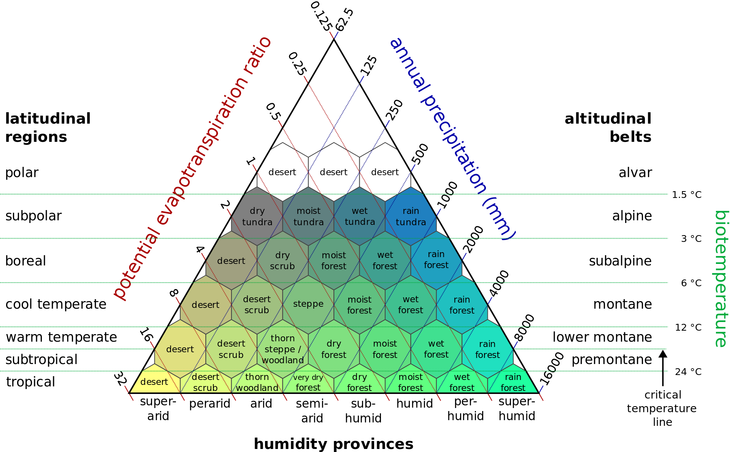
Snow
Tundra
Desert
Savannah
Grassland

Slide 2
Biomes
θ = π
Desert
Tundra
Snow
Grassland
Savannah
Moisture
θ = 0
θ
Moisture
Elevation

